Slide 1

Tiny Tips Marketing
Branding & Marketing Simply

Slide 2
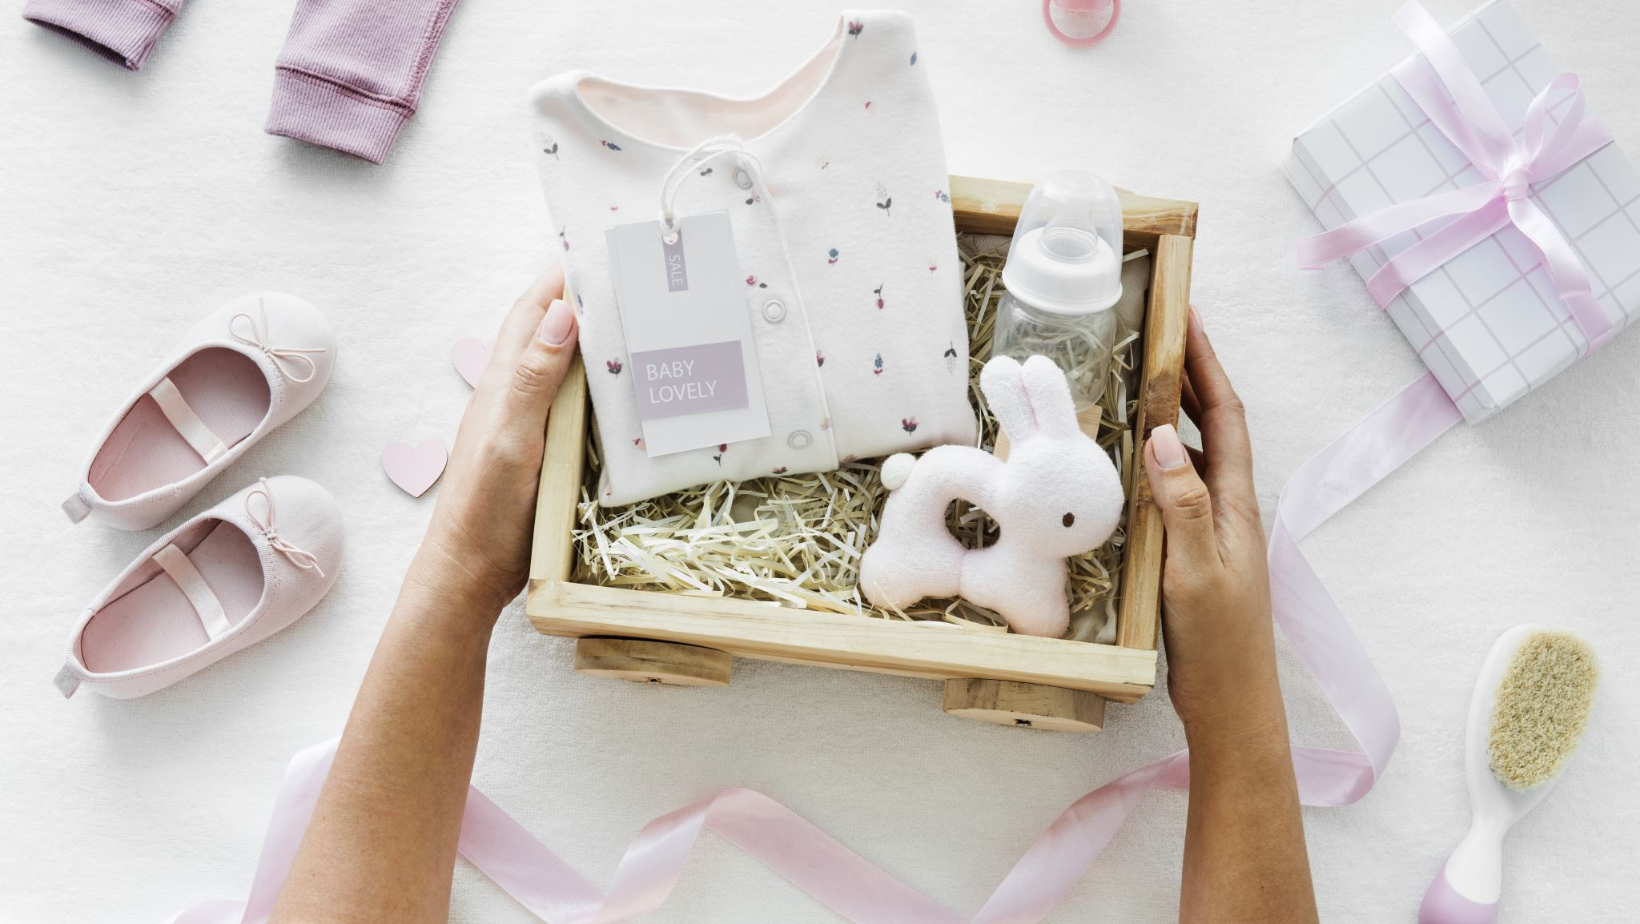
New Born Baby Products

